Slide 1
Youtube’s adult contents detection
-------------------/
based on
titles and descriptions.
/-------------------------------

Slide 2
Abstract
=> The project will cover some concepts :
Natural Language Processing Reviews
Project’s Introduction
How to get data ?
Data pre-processing
Model construction
Training
Testing results

Slide 3
NLP review.
Natural language Processing (NLP) is a subfield of artificial intelligence. The goal of NLP is to make computers understand the unstructured text and retrieve meaningful pieces of information from it.
Some applications of NLP:
Machine Translation.
Speech Recognition.
Chatbot.
Text Classifications.
Spell Checking.
Spam Detection.
Autocomplete.
Predictive Typing.

Slide 4
Project’s Introduction
Nowadays, children are getting familiar with social network.
Youtube is one of those social network that contain inappropriate contents for children.
We decided to help with our project.
First, we collected and pre-processed data of Youtube’s videos.
Next, we divided data into 3 classes: adult, violence and horror.
These data will be used for training model.
Finally, model will be applied to classify titles and descriptions of videos.

Slide 5
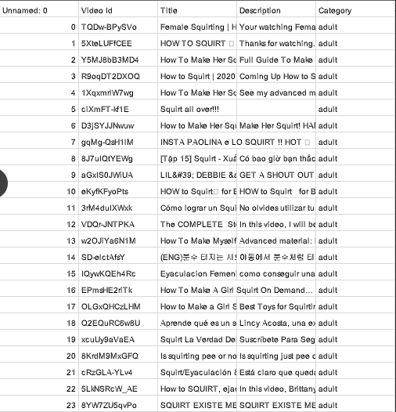
Data preparation
We use Youtube Data API v3 to collect data.
We have collected the total of about 21803 data,
divided into 3 classes : adult, violence and horror. There should be about 7000 data for each class.
Train size :70%
Validation size : 15%
Test size :15%

Slide 6
Data preprocessing
Why do we need to pre-process text data ?
Some involved steps:
Remove null samples
Remove non-alphabet characters and convert word to lowercases
Remove stop-words
Remove url links
Lemmatization / Stemming
Text to sequences - pad sequences

Slide 7

Data preprocessing
Remove stopwords
=> tiết kiệm bộ nhớ

Slide 8
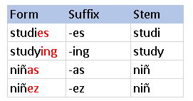
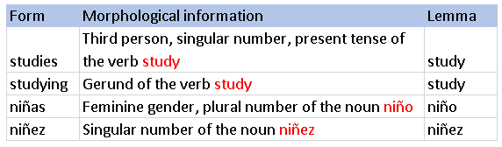
Data preprocessing
- Remove url links
Something starts with https …
- Lemmatization / Stemming
Stemming
Lemmatization

Slide 9
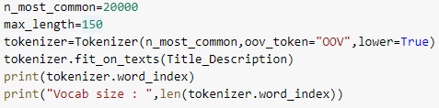
Data preprocessing
Pad sequences
Tokenizer (from keras.preprocessing.text). A tokenizer object is created to map each word in dataset with an index in a dictionary .

Slide 10
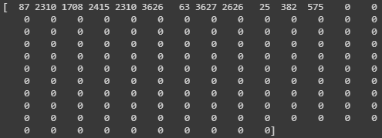
Data preprocessing

Slide 11
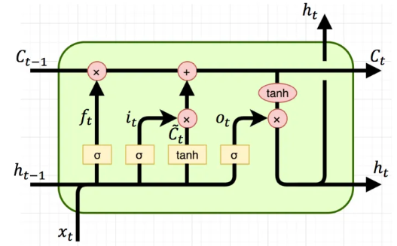
Model Constructions
Fundamental LSTM
Forget Gate
Input Gate
Output Gate

Slide 12
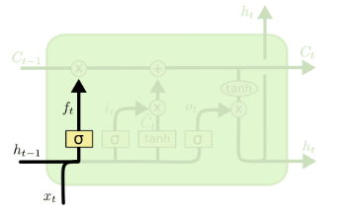

Model Constructions
Forget Gate

Slide 13
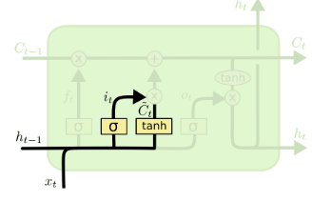

Model Constructions
Input Gate

Slide 14
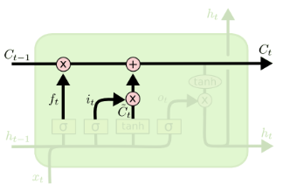

Model Constructions
Update cell state

Slide 15
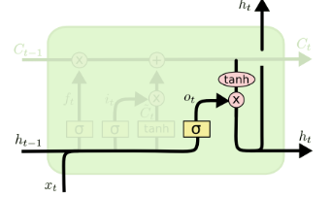

Model Constructions
Output gate

Slide 16
Model Constructions
Two LSTM ‘s Variants will be used in this project :
a) GRU.
b) Bidirectional LSTM.

Slide 17
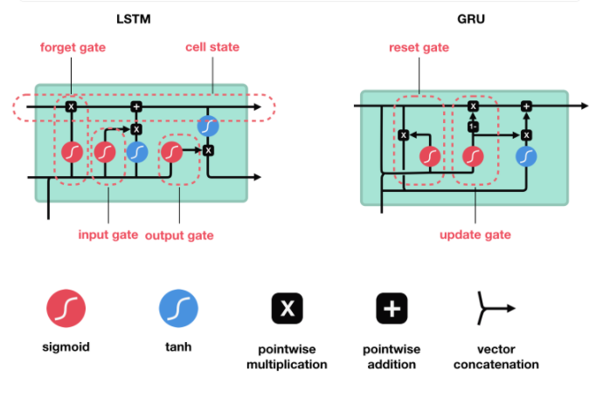
Model Constructions
GRU

Slide 18
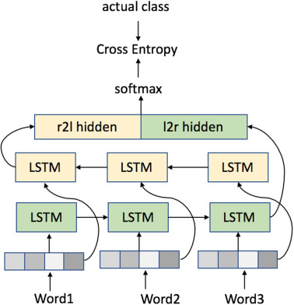
Model Constructions
b) Bidirectional LSTM

Slide 19
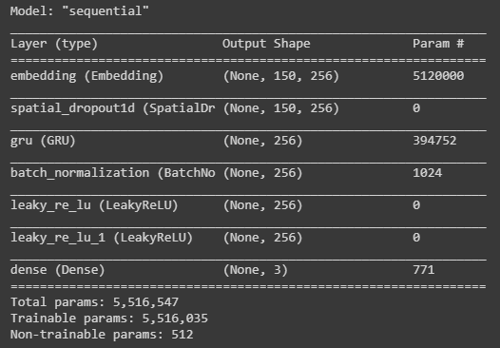
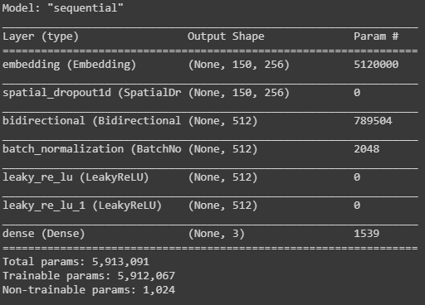
Training Results
Learning rate : 0.001 , embedding size : 256, vocabulary size : 20000, output size :3 , batch size :128, epoch : 5

Slide 20
Training Results
Learning rate : 0.001 , embedding size : 256, vocabulary size : 20000, output size :3 , batch size :128, epoch : 5
Model | Test loss and Test Accuracy
GRU
Bidirectional LSTM

Slide 21
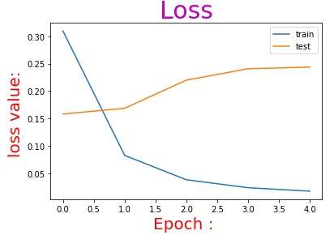
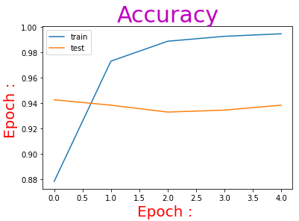
Training Results
Bi-LSTM

Slide 22
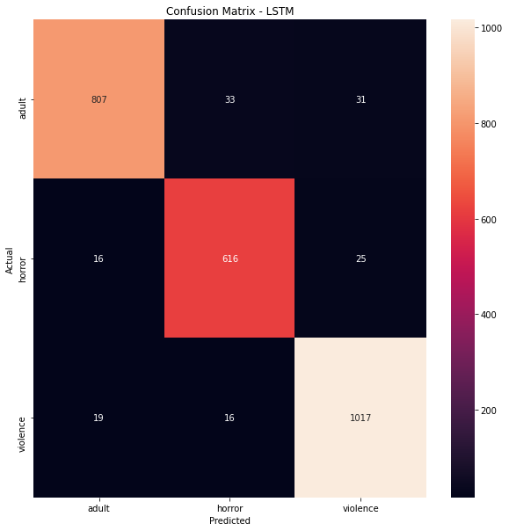
Training Results
Bi-LSTM

Slide 23
Comments :Applications and Expansion
The high accuracy can be explained easily as the dataset is quite simple, the length of each sample after concatenation 2 columns (title and description ) is still short . Consequently, the dataset is not complicated .
The project will be applied for ranking video based on titles and descriptions. For example adult contents is available for 18+ , horror is available for 16+ or violence is for 21+ , …
References:
https://colah.github.io/posts/2015-08-Understanding-LSTMs/
https://nttuan8.com/bai-14-long-short-term-memory-lstm/
https://nttuan8.com/bai-13-recurrent-neural-network/
https://developers.google.com/youtube/v3/quickstart/python
https://www.tensorflow.org/api_docs/python/tf/keras/preprocessing/sequence/pad_sequences

Slide 24
Thank you for listening!

